Slide 1
NT219- Cryptography
Week 4: Modern Symmetric Ciphers
PhD. Ngoc-Tu Nguyen
tunn@uit.edu.vn

Slide 2
Outline
Stream Cipher
Block cipher
Data Encryption Standard (DES)
Advanced Encryption Standard (AES)
Mode of operation
Some other ciphers
Searchable encryption
Homomorphic encryption
Attribute based encryption
Notes:
Cipher=a secret system of writing;

Slide 3
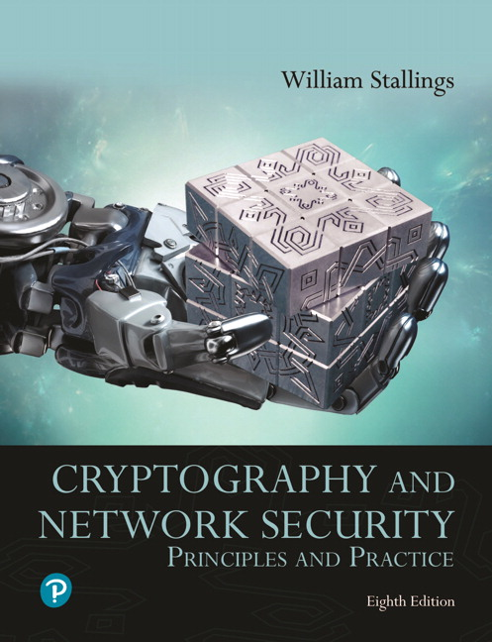

Textbooks and References
Text books
[1] Chapter 4,6
[2] Chapter 5

Slide 4
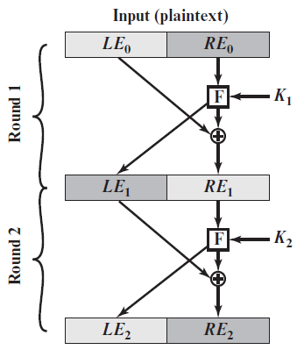
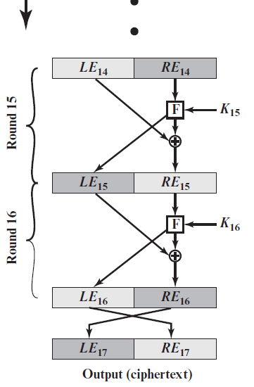
DES review
64 bits

Slide 5
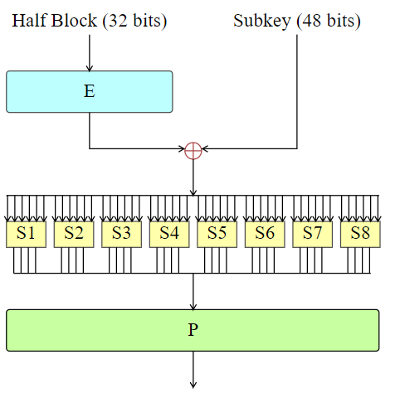
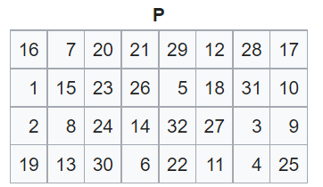
DES review
F(R_{i–1}, K_{i}) = P(S(EP(R_{i–1}) ⊕ K_{i})), i = 1,…,16
Substitution
Permutation

Slide 6
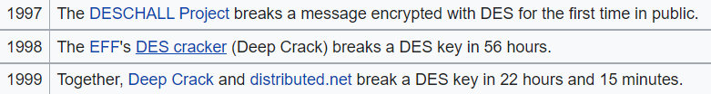
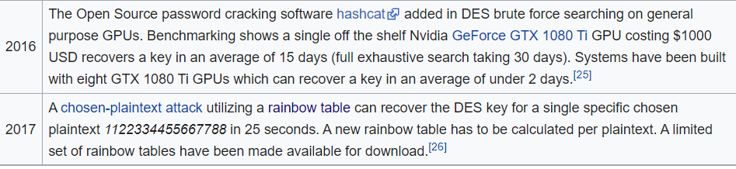
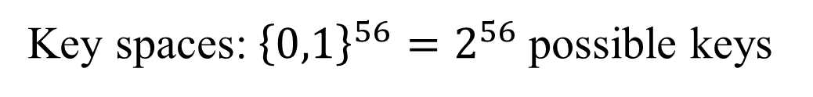
DES review
Security analysis
Key spaces: ${\left\{0,1\right\}}^{56}=2^{56}$possible keys
Brute Force attacks
https://en.wikipedia.org/wiki/Data_Encryption_Standard

Slide 7
Outline
Stream Cipher
Block cipher
Data Encryption Standard (DES)
Advanced Encryption Standard (AES)
Some other ciphers
Searchable encryption
Homomorphic encryption
Attribute based encryption
Notes:
Cipher=a secret system of writing;

Slide 8
Finite Field Arithmetic (1/3)
p is a prime number
is a finite field;
N=2^{n} is a composite number
NO!
is a finite field?
Example:
But is a finite field!

Slide 9
Finite Field Arithmetic (2/3)
If one of the operations used in the algorithm is division, then we need to work in arithmetic defined over a field
Division requires: nonzero element have a multiplicative inverse
For convenience and for implementation efficiency we would like to work with integers that fit exactly into a given number of bits with no wasted bit patterns
Integers in the range 0 through 2^{n} – 1, which fit into an n-bit word
The set of such integers, Z₂^{n}, using modular arithmetic, is not a field
The integer 2 has no multiplicative inverse in Z₂^{n}, (no integer b, such that 2b mod 2^{n} = 1)
A finite field containing 2^{n} elements is referred to as G F(2^{n})
Every polynomial in G F(2^{n}) can be represented by an n-bit number

Slide 10
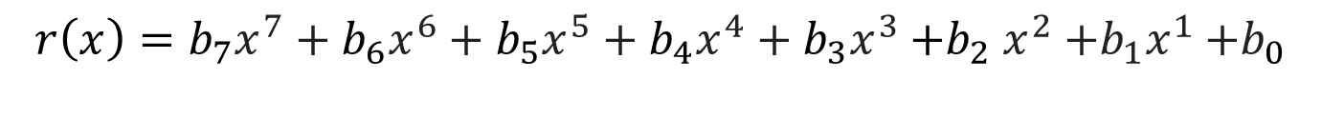
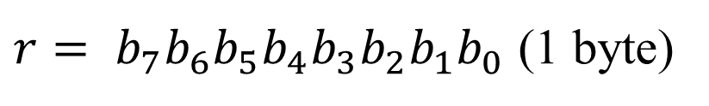
Finite Field Arithmetic (3/3)
In the Advanced Encryption Standard (A E S) all operations are performed on 8-bit (1 byte);
The arithmetic operations of addition, multiplication, and division are performed over the finite field G F(2⁸)
Rijndael's finite field
GF(2)[x]/(x⁸ + x⁴ + x³ + x + 1)
$$r\left(x\right)={b_{7}x^{7}+b_{6}x^{6}+b_{5}x^{5}+b_{4}x^{4}+b_{3}x^{3}{+b}_{2}x^{2}{+b_{1}x}^{1}+b}_{0}$$
$r= b_{7}b_{6}b_{5}b_{4}b_{3}b_{2}b_{1}b_{0}$ (1 byte)

Slide 11
Advanced Encryption Standard
Advanced Encryption Standard competition began in 1997
Rijndael was selected to be the new AES in 2001
AES basic structures:
block cipher, but not Feistel cipher
encryption and decryption are similar, but not symmetrical
basic unit: byte, not bit
block size: 16-bytes (128 bits)
three different key lengths: 128, 192, 256 bits
AES-128, AES-192, AES-256
each 16-byte block is represented as a 4 x 4 square matrix, called the state matrix
the number of rounds depends on key lengths
4 simple operations on the state matrix every round (except the last round)

Slide 12
The Four Simple Operations
substitute-bytes (sub)
Non-linear operation based on a defined substitution box
Used to resist cryptanalysis and other mathematical attacks
shift-rows (shr)
Linear operation for producing diffusion
mix-columns (mic)
Elementary operation also for producing diffusion
add-round-key (ark)
Simple set of ⊕ operations on state matrices
Linear operation
Produces confusion

Slide 13
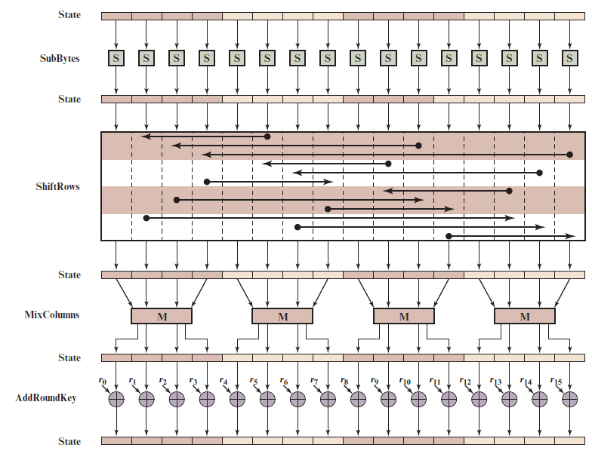
A E S Encryption Round
Notes:
Figure 6.4 depicts the structure of a full encryption round.

Slide 14
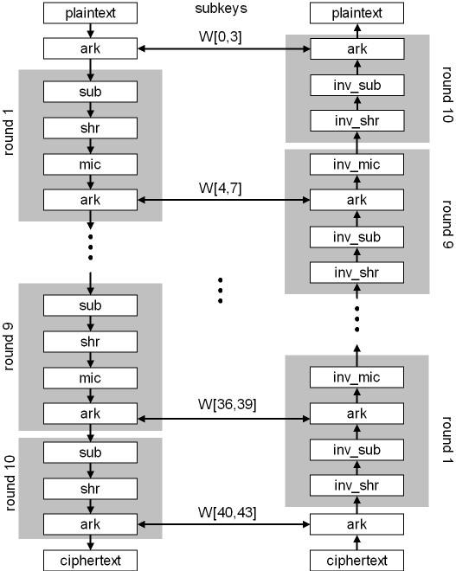
AES-128

Slide 15
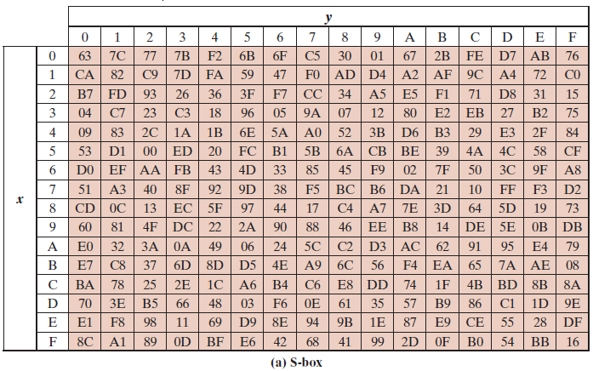
AES S-Boxes (1 of 2)

Slide 16
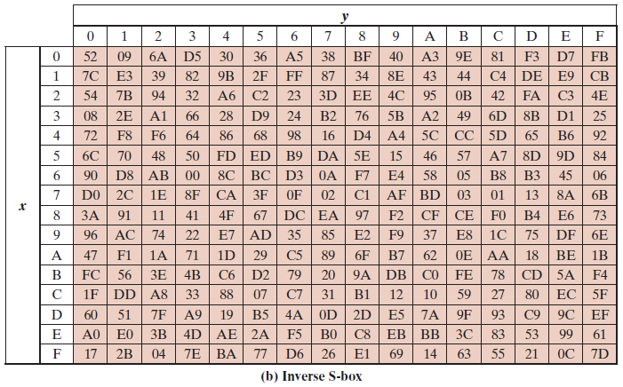
AES S-Boxes (2 of 2)
Notes:
The inverse substitute byte transformation , called InvSubBytes, makes use
of the inverse S-box shown in Table 6.2b.

Slide 17
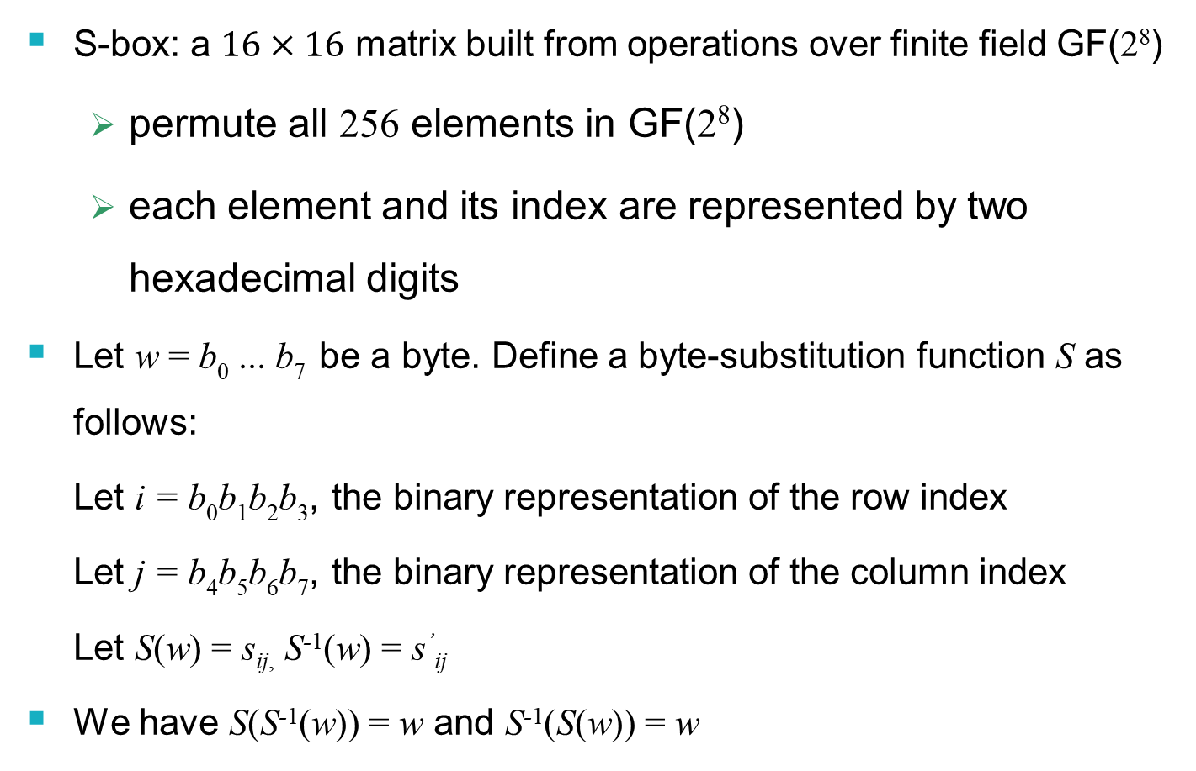
AES S-Box
S-box: a $16×16$ matrix built from operations over finite field GF(2⁸)
permute all 256 elements in GF(2⁸)
each element and its index are represented by two hexadecimal digits
Let w = b₀ ... b₇ be a byte. Define a byte-substitution function S as follows:
Let i = b₀b₁b₂b₃, the binary representation of the row index
Let j = b₄b₅b₆b₇, the binary representation of the column index
Let S(w) = s_{ij,} S⁻¹(w) = s’_{ij}
We have S(S⁻¹(w)) = w and S⁻¹(S(w)) = w

Slide 18
Substitute-Bytes (sub)
Substitution function that takes a byte as an input, uses its first four bits as the row index and the last four bits as the column index, and outputs a byte using a table-lookup at the S-box
Let A be a state matrix. Then
S(a_{0,0} ) S(a_{0,1} ) S(a_{0,2} ) S(a_{0,3} )
sub(A) = S(a_{1,0} ) S(a_{1,1} ) S(a_{1,2} ) S(a_{1,3} )
S(a_{2,0} ) S(a_{2,1} ) S(a_{2,2} ) S(a_{2,3} )
S(a_{3,0} ) S(a_{3,1} ) S(a_{3,2} ) S(a_{3,3} )
sub⁻¹(A) will just be the inverse substitution operation applied to the matrix
S⁻¹ (a_{0,0} ) S⁻¹ (a_{0,1} ) S⁻¹ (a_{0,2} ) S⁻¹ (a_{0,3} )
sub⁻¹ (A) = S⁻¹ (a_{1,0} ) S⁻¹ (a_{1,1} ) S⁻¹ (a_{1,2} ) S⁻¹ (a_{1,3} )
S⁻¹ (a_{2,0} ) S⁻¹ (a_{2,1} ) S⁻¹ (a_{2,2} ) S⁻¹ (a_{2,3} )
S⁻¹ (a_{3,0} ) S⁻¹ (a_{3,1} ) S⁻¹ (a_{3,2} ) S⁻¹ (a_{3,3} )
We have sub(sub⁻¹(A)) = sub⁻¹(sub(A)) = A

Slide 19
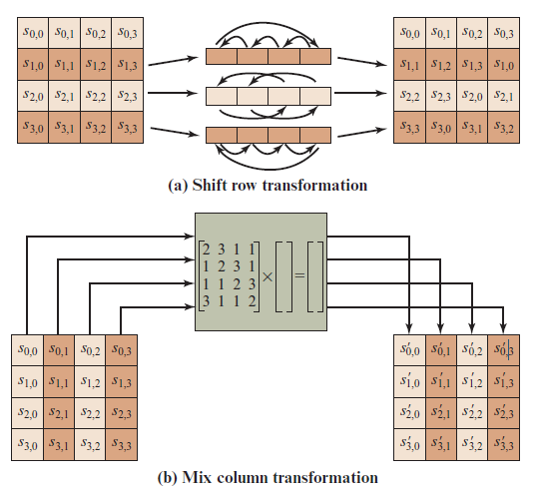
A E S Row and Column Operations
Notes:
The forward shift row transformation ,
called ShiftRows, is depicted in Figure 6.7a. The first row of State is not altered. For
the second row, a 1-byte circular left shift is performed. For the third row, a 2-byte
circular left shift is performed. For the fourth row, a 3-byte circular left shift is performed.
The following is an example of ShiftRows.
The inverse shift row transformation , called InvShiftRows, performs the circular
shifts in the opposite direction for each of the last three rows, with a 1-byte
circular right shift for the second row, and so on.
The forward mix column transformation,
called MixColumns, operates on each column individually. Each byte of a column
is mapped into a new value that is a function of all four bytes in that column. The
transformation can be defined by the following matrix multiplication on State
(Figure 6.7b)
Each element in the product matrix is the sum of products of elements of one row
and one column. In this case, the individual additions and multiplications are
performed in GF(2⁸ ).

Slide 20
Shift-Rows (shr)
shr(A) performs a left-circular-shift i – 1 times on the i-th row in the matrix A
a_{0,0} a_{0,1} a_{0,2} a_{0,3}
shr(A) = a_{1,1} a_{1,2} a_{1,3} a_{1,0}
a_{2,2} a_{2,3} a_{2,0} a_{2,1}
a_{3,3} a_{3,0} a_{3,1} a_{3,2}
shr⁻¹(A) performs a right-circular-shift i – 1 times on the i-th row in the matrix A
a_{0,0} a_{0,1} a_{0,2} a_{0,3}
shr⁻¹(A)= a_{1,3} a_{1,0} a_{1,1} a_{1,2}
a_{2,2} a_{2,3} a_{2,0} a_{2,1}
a_{3,1} a_{3,2} a_{3,3} a_{3,0}
We have shr(shr⁻¹(A)) = shr⁻¹(shr(A)) = A

Slide 21
Mix-Columns (mic)
mic(A) = [a’_{ij}]_{4×4} is determined by the following operation (j = 0, 1, 2, 3):
a’_{0,j} = M (a_{0,j}) ⊕ [M (a_{1,j}) ⊕ a_{1,j}] ⊕ a_{2,j} ⊕ a_{3,j}
a’_{1,j} = a_{0,j} ⊕ M (a_{1,j}) ⊕ [M (a_{2,j} )⊕a_{2,j}] ⊕ a_{3,j}
a’_{2,j} = a_{0,j} ⊕ a_{1,j} ⊕ M (a_{2,j} ) ⊕ [M (a_{3,j} ) ⊕ a_{3,j}]
a’_{3,j} = [M (a_{0,j} )⊕ a_{0,j} ] ⊕ a_{1,j} ⊕ a_{2,j} ⊕ M (a_{3,j} )
mic⁻¹(A) is defined as follows:
Let w be a byte and i a positive integer:
M ^{i}(w) = M (M ^{i-1}(w)) (i > 1), M ¹(w) = M (w)
Let
M₁(w) = M³(w) ⊕ M²(w) ⊕ M(w)
M₂(w) = M³(w) ⊕ M(w) ⊕ w
M₃(w) = M³(w) ⊕ M²(w) ⊕ w
M₄(w) = M³(w) ⊕ w
mic⁻¹(A) = [a’’_{ij}]_{4×4} :
a’’_{0,j} = M₁(a_{0,j}) ⊕ M₂(a_{1,j}) ⊕ M₃(a_{2,j}) ⊕ M₄(a_{3,j})
a’’_{1,j} = M₄(a_{0,j}) ⊕ M₁(a_{1,j}) ⊕ M₂(a_{2,j}) ⊕ M₃(a_{3,j})
a’’_{2,j} = M₃(a_{0,j}) ⊕ M₄(a_{1,j}) ⊕ M₁(a_{2,j}) ⊕ M₂(a_{3,j})
a’’_{3,j} = M₂(a_{0,j}) ⊕ M₃(a_{1,j}) ⊕ M₄(a_{2,j}) ⊕ M₁(a_{3,j})
We have mic(mic⁻¹(A)) = mic⁻¹(mic(A)) = A

Slide 22
AES-128 Round Keys
Let K = K[0,31]K[32,63]K[64,95]K[96,127] be a 4-word encryption key
AES expands K into a 44-word array W[0,43]
Define a byte transformation function M as follows:
b₆b₅b₄b₃b₂b₁b₀0, if b₇ = 0,
M (b₇b₆b₅b₄b₃b₂b₁b₀) =
b₆b₅b₄b₃b₂b₁b₀0 ⊕ 00011011, if b₇ = 1
Next, let j be a non-negative number. Define m(j) as follows:
00000001, if j = 0
m(j) = 00000010, if j = 1
M (m(j–1)), if j > 1
Finally, define a word-substitution function T as follows, which transforms a 32-bit string into a 32-bit string, using parameter j and the AES S-Box:
T(w, j) = [(S(w₂) ⊕ m(j – 1)]S(w₃) S(w₄) S(w₁),
where w = w₁w₂w₃w₄ with each w_{i} being a byte

Slide 23
Putting Things Together
Use all of these functions to create round keys of size 4 words (11 round keys are needed for AES-128; i.e. 44 words)
W[0] = K[0, 31]
W[1] = K[32, 63]
W[2] = K[64, 95]
W[3] = K[96, 127]
W[i–4] ⊕ T(W[i–1], i/4), if i is divisible by 4
W[i] =
W[i–4] ⊕ W[i–1], otherwise
i = 4, …, 43
11 round keys: For i = 0, …, 10:
K_{i} = W[4i, 4i + 3] = W[4i + 0] W[4i + 1] W[4i + 2] W[4i + 3]

Slide 24
Add Round Keys (ark)
Rewrite K_{i} as a 4 x 4 matrix of bytes:
k_{0,0} k_{0,1} k_{0,2} k_{0,3}
K_{i} = k_{1,0} k_{1,1} k_{1,2} k_{1,3}
k_{2,0} k_{2,1} k_{2,2} k_{2,3}
k_{3,0} k_{3,1} k_{3,2} k_{3,3}
where each element is a byte and W[4i + j] = k_{0,j}k_{1,j}k_{2,j}k_{3,j}, j = 0, 1 , 2, 3
Initially, let a = M
k_{0,0}⊕ a_{0,0} k_{0,1}⊕ a_{0,1} k_{0,3} ⊕ a_{0,3} k_{0,4} ⊕ a_{0,4}
ark(a, K_{i}) = a ⊕ K_{i} = k_{1,0}⊕ a_{1,0} k_{1,1}⊕ a_{1,1} k_{1,2} ⊕ a_{1,2} k_{1,3} ⊕ a_{1,3} k_{2,0}⊕ a_{2,0} k_{2,1}⊕ a_{2,1} k_{2,2} ⊕ a_{2,2} k_{2,3} ⊕ a_{2,3} k_{3,0}⊕ a_{3,0} k_{3,1}⊕ a_{3,1} k_{3,2} ⊕ a_{3,2} k_{3,3} ⊕ a_{3,3}
Since this is a ⊕ operation, ark^{–1} is the same as ark. We have
ark(ark^{–1}(a, K_{i}), K_{i}) = ark^{–1}(ark(a, K_{i}), K_{i}) = a

Slide 25
AES-128 Encryption/Decryption
AES-128 encryption:
Let A_{i} (i = 0, …, 11) be a sequence of state matrices, where A₀ is the initial state matrix M, and A_{i} (i = 1, …, 10) represents the input state matrix at round i
A₁₁ is the cipher text block C, obtained as follows:
A₁ = ark(A₀, K₀)
A_{i+1} = ark(mic(shr(sub(A_{i}))), K_{i}), i = 1,…,9
A₁₁ = arc(shr(sub(A₁₀)), K₁₀))
AES-128 decryption:
Let C₀ = C = A₁₁, where C_{i} is the output state matrix from the previous round
C₁ = ark(C₀, K₁₀)
C_{i+1} = mic⁻¹(ark(sub ⁻¹(shr ⁻¹(C_{i})), K_{10-i})), i = 1,…,9
C₁₁ = ark(sub ⁻¹(shr ⁻¹(C₁₀)), K₀)

Slide 26
Correctness Proof of Decryption
We now show that C₁₁ = A₀
We first show the following equality using mathematical induction:
C_{i} = shr(sub(A_{11-i})), i = 1, …, 10
For i = 1 we have
C₁ = ark(A₁₁, K₁₀)
= A₁₁ ⊕ K₁₀
= ark(shr(sub(A₁₀)), K₁₀) ⊕ K₁₀
= (shr(sub(A₁₀)) ⊕ K₁₀) ⊕ K₁₀
= shr(sub(A₁₀))
Assume that the equality holds for 1 ≤ i ≤ 10. We have
C_{i+1} = mic⁻¹(ark(sub ⁻¹(shr ⁻¹(C_{i})), K_{10-i}))
= mic⁻¹(ark(sub ⁻¹(shr ⁻¹(shr(sub(A_{11-i})))) ⊕ K_{10-i}))
= mic⁻¹(A_{11-i}⊕ K_{10-i})
= mic⁻¹(ark(mic(shr(sub(A_{10-i}))), K_{10-i}) ⊕ K_{10-i})
= mic⁻¹([mic(shr(sub(A_{10-i}))) ⊕ K_{10-i}] ⊕ K_{10-i})
= shr(sub(A_{10-i})
= shr(sub(A_{11-(i+1)}))
This completes the induction proof

Slide 27
Correctness Proof of Decryption
Finally, we have
C₁₁ = ark(sub⁻¹(shr⁻¹(C₁₀)), K₀)
= sub⁻¹(shr⁻¹(shr(sub(A₁)))) ⊕ K₀
= A₁ ⊕ K₀
= (A₀ ⊕ K₀) ⊕ K₀
= A₀
This completes the correctness proof of AES-128 Decryption

Slide 28
A E S Key Expansion
Takes as input a four-word (16 byte) key and produces a linear array of 44 words (176) bytes
This is sufficient to provide a four-word round key for the initial AddRoundKey stage and each of the 10 rounds of the cipher
Key is copied into the first four words of the expanded key
The remainder of the expanded key is filled in four words at a time
Each added word w[i] depends on the immediately preceding word, w[i – 1], and the word four positions back, w[i – 4]
In three out of four cases a simple X O R is used
For a word whose position in the w array is a multiple of 4, a more complex function is used
Notes:
The AES key expansion algorithm takes as input a four-word (16-byte) key and
produces a linear array of 44 words (176 bytes). This is sufficient to provide a four word
round key for the initial AddRoundKey stage and each of the 10 rounds of the
cipher. The pseudocode on the next page describes the expansion.
The key is copied into the first four words of the expanded key. The remainder
of the expanded key is filled in four words at a time. Each added word w [i]
depends on the immediately preceding word, w [i - 1], and the word four positions
back, w [i - 4]. In three out of four cases, a simple ⊕ is used. For a word whose
position in the w array is a multiple of 4, a more complex function is used.

Slide 29
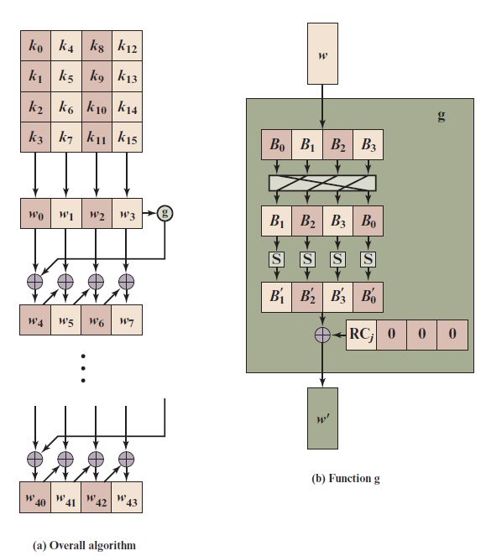
A E S Key Expansion
Notes:
Figure 6.9 illustrates the generation of the expanded key, using the symbol g to represent that
complex function.

Slide 30
Key Expansion Rationale (1 of 2)
The Rijndael developers designed the expansion key algorithm to be resistant to known cryptanalytic attacks
Inclusion of a round-dependent round constant eliminates the symmetry between the ways in which round keys are generated in different rounds
Notes:
The Rijndael developers designed the expansion key algorithm to be resistant to
known cryptanalytic attacks. The inclusion of a round-dependent round constant
eliminates the symmetry, or similarity, between the ways in which round keys are
generated in different rounds. The specific criteria that were used are [DAEM99]
• Knowledge of a part of the cipher key or round key does not enable calculation
of many other round-key bits.
• An invertible transformation [i.e., knowledge of any Nk consecutive words of
the expanded key enables regeneration of the entire expanded key (Nk = key
size in words)].
• Speed on a wide range of processors.
• Usage of round constants to eliminate symmetries.
• Diffusion of cipher key differences into the round keys; that is, each key bit
affects many round key bits.
• Enough nonlinearity to prohibit the full determination of round key differences
from cipher key differences only.
• Simplicity of description.
The authors do not quantify the first point on the preceding list, but the idea
is that if you know less than Nk consecutive words of either the cipher key or one of
the round keys, then it is difficult to reconstruct the remaining unknown bits. The
fewer bits one knows, the more difficult it is to do the reconstruction or to determine
other bits in the key expansion.

Slide 31
Key Expansion Rationale (2 of 2)
The specific criteria that were used are:
Knowledge of a part of the cipher key or round key does not enable calculation of many other round-key bits
An invertible transformation
Speed on a wide range of processors
Usage of round constants to eliminate symmetries
Diffusion of cipher key differences into the round keys
Enough nonlinearity to prohibit the full determination of round key differences from cipher key differences only
Simplicity of description
Notes:
The Rijndael developers designed the expansion key algorithm to be resistant to
known cryptanalytic attacks. The inclusion of a round-dependent round constant
eliminates the symmetry, or similarity, between the ways in which round keys are
generated in different rounds. The specific criteria that were used are [DAEM99]
• Knowledge of a part of the cipher key or round key does not enable calculation
of many other round-key bits.
• An invertible transformation [i.e., knowledge of any Nk consecutive words of
the expanded key enables regeneration of the entire expanded key (Nk = key
size in words)].
• Speed on a wide range of processors.
• Usage of round constants to eliminate symmetries.
• Diffusion of cipher key differences into the round keys; that is, each key bit
affects many round key bits.
• Enough nonlinearity to prohibit the full determination of round key differences
from cipher key differences only.
• Simplicity of description.
The authors do not quantify the first point on the preceding list, but the idea
is that if you know less than Nk consecutive words of either the cipher key or one of
the round keys, then it is difficult to reconstruct the remaining unknown bits. The
fewer bits one knows, the more difficult it is to do the reconstruction or to determine
other bits in the key expansion.

Slide 32
Example Round Key Calculation
Description | Value
i (decimal) | 36
temp = w[i − 1] | 7F8D292F
RotWord (temp) | 8D292F7F
SubWord (RotWord (temp)) | 5DA515D2
Rcon (9) | 1B000000
SubWord (RotWord (temp)) ⊕ Rcon (9) | 46A515D2
w[i − 4] | EAD27321
w[i] = w[i − 4] ⊕ SubWord (RotWord (temp)) ⊕ Rcon (9) | AC7766F3
Notes:
Table 6.3. Example Round Key Calculation

Slide 33
Key Expansion for A E S Example (1 of 3)
Key Words | Auxiliary Function
w0 = 0f 15 71 c9 w1 = 47 d9 e8 59 w2 = 0c b7 ad d6 w3 = af 7f 67 98 | RotWord (w3) = 7f 67 98 af = x1 SubWord (x1) = d2 85 46 79 = y1 Rcon (1) = 01 00 00 00 y1 ⊕ Rcon (1) = d3 85 46 79 = z1
w4 = w0 ⊕ z1 = dc 90 37 b0 w5 = w4 ⊕ w1 = 9b 49 df e9 w6 = w5 ⊕ w2 = 97 fe 72 3f w7 = w6 ⊕ w3 = 38 81 15 a7 | RotWord (w7) = 81 15 a7 38 = x2 SubWord (x2) = 0c 59 5c 07 = y2 Rcon (2) = 02 00 00 00 y2 ⊕ Rcon (2) = 0e 59 5c 07 = z2
w8 = w4 ⊕ z2 = d2 c9 6b b7 w9 = w8 ⊕ w5 = 49 80 b4 5e w10 = w9 ⊕ w6 = de 7e c6 61 w11 = w10 ⊕ w7 = e6 ff d3 c6 | RotWord (w11) = ff d3 c6 e6 = x3 SubWord (x3) = 16 66 b4 83 = y3 Rcon (3) = 04 00 00 00 y3 ⊕ Rcon (3) = 12 66 b4 8e = z3
Notes:
Table 6.4 shows the expansion of the 16-byte key into 10 round keys. As previously explained, this process is performed word by word, with each four-byte word occupying one column of the word round-key matrix. The left-hand column shows the four round-key words generated for each round. The right-hand column shows
the steps used to generate the auxiliary word used in key expansion. We begin, of course, with the key itself serving as the round key for round 0.

Slide 34
Key Expansion for A E S Example (2 of 3)
Key Words | Auxiliary Function
w12 = w8 ⊕ z3 = c0 af df 39 w13 = w12 ⊕ w9 = 89 2f 6b 67 w14 = w13 ⊕ w10 = 57 51 ad 06 w15 = w14 ⊕ w11 = b1 ae 7e c0 | RotWord (w15) = ae 7e c0 b1 = x4 SubWord (x4) = e4 f3 ba c8 = y4 Rcon (4) = 08 00 00 00 y4 ⊕ Rcon (4) = ec f3 ba c8 = 4
w16 = w12 ⊕ z4 = 2c 5c 65 f1 w17 = w16 ⊕ w13 = a5 73 0e 96 w18 = w17 ⊕ w14 = f2 22 a3 90 w19 = w18 ⊕ w15 = 43 8c dd 50 | RotWord (w19) = 8c dd 50 43 = x5 SubWord (x5) = 64 c1 53 1a = y5 Rcon(5) = 10 00 00 00 y5 ⊕ Rcon (5) = 74 c1 53 1a = z5
w20 = w16 ⊕ z5 = 58 9d 36 eb w21 = w20 ⊕ w17 = fd ee 38 7d w22 = w21 ⊕ w18 = 0f cc 9b ed w23 = w22 ⊕ w19 = 4c 40 46 bd | RotWord (w23) = 40 46 bd 4c = x6 SubWord (x6) = 09 5a 7a 29 = y6 Rcon(6) = 20 00 00 00 y6 ⊕ Rcon(6) = 29 5a 7a 29 = z6
Notes:
Table 6.4 shows the expansion of the 16-byte key into 10 round keys. As previously explained, this process is performed word by word, with each four-byte word occupying one column of the word round-key matrix. The left-hand column shows the four round-key words generated for each round. The right-hand column shows
the steps used to generate the auxiliary word used in key expansion. We begin, of course, with the key itself serving as the round key for round 0.

Slide 35
Key Expansion for A E S Example (3 of 3)
Key Words | Auxiliary Function
w24 = w20 ⊕ z6 = 71 c7 4c c2 w25 = w24 ⊕ w21 = 8c 29 74 bf w26 = w25 ⊕ w22 = 83 e5 ef 52 w27 = w26 ⊕ w23 = cf a5 a9 ef | RotWord (w27) = a5 a9 ef cf = x7 SubWord (x7) = 06 d3 bf 8a = y7 Rcon (7) = 40 00 00 00 y7 ⊕ Rcon(7) = 46 d3 df 8a = z7
w28 = w24 ⊕ z7 = 37 14 93 48 w29 = w28 ⊕ w25 = bb 3d e7 f7 w30 = w29 ⊕ w26 = 38 d8 08 a5 w31 = w30 ⊕ w27 = f7 7d a1 4a | RotWord (w31) = 7d a1 4a f7 = x8 SubWord (x8) = ff 32 d6 68 = y8 Rcon (8) = 80 00 00 00 y8 ⊕ Rcon(8) = 7f 32 d6 68 = z8
w32 = w28 ⊕ z8 = 48 26 45 20 w33 = w32 ⊕ w29 = f3 1b a2 d7 w34 = w33 ⊕ w30 = cb c3 aa 72 w35 = w34 ⊕ w32 = 3c be 0b 3 | RotWord (w35) = be 0b 38 3c = x9 SubWord (x9) = ae 2b 07 eb = y9 Rcon (9) = 1B 00 00 00 y9 ⊕ Rcon (9) = b5 2b 07 eb = z9
w36 = w32 ⊕ z9 = fd 0d 42 cb w37 = w36 ⊕ w33 = 0e 16 e0 1c w38 = w37 ⊕ w34 = c5 d5 4a 6e w39 = w38 ⊕ w35 = f9 6b 41 56 | RotWord (w39) = 6b 41 56 f9 = x10 SubWord (x10) = 7f 83 b1 99 = y10 Rcon (10) = 36 00 00 00 y10 ⊕ Rcon (10) = 49 83 b1 99 = z10
w40 = w36 ⊕ z10 = b4 8e f3 52 w41 = w40 ⊕ w37 = ba 98 13 4e w42 = w41 ⊕ w38 = 7f 4d 59 20 w43 = w42 ⊕ w39 = 86 26 18 76
Notes:
Table 6.4 shows the expansion of the 16-byte key into 10 round keys. As previously explained, this process is performed word by word, with each four-byte word occupying one column of the word round-key matrix. The left-hand column shows the four round-key words generated for each round. The right-hand column shows
the steps used to generate the auxiliary word used in key expansion. We begin, of course, with the key itself serving as the round key for round 0.

Slide 36
A E S Example (1 of 2)
Start of Round | After SubBytes | After ShiftRows | After MixColumns | Round Key
01 89 fe 76 23 ab dc 54 45 cd ba 32 67 ef 98 10 |  |  |  | 0f 47 0c af 15 d9 b7 7f 71 e8 ad 67 c9 59 d6 98
0e ce f2 d9 36 72 6b 2b 34 25 17 55 ae b6 4e 88 | ab 8b 89 35 05 40 7f f1 18 3f f0 fc e4 4e 2f c4 | ab 8b 89 35 40 7f f1 05 f0 fc 18 3f c4 e4 4e 2f | b9 94 57 75 e4 8e 16 51 47 20 9a 3f c5 d6 f5 3b | dc 9b 97 38 90 49 fe 81 37 df 72 15 b0 e9 3f a7
65 0f c0 4d 74 c7 e8 d0 70 ff e8 2a 75 3f ca 9c | 4d 76 ba e3 92 c6 9b 70 51 16 9b e5 9d 75 74 de | 4d 76 ba e3 c6 9b 70 92 9b e5 51 16 de 9d 75 74 | 8e 22 db 12 b2 f2 dc 92 df 80 f7 c1 2d c5 1e 52 | d2 49 de e6 c9 80 7e ff 6b b4 c6 d3 b7 5e 61 c6
5c 6b 05 f4 7b 72 a2 6d b4 34 31 12 9a 9b 7f 94 | 4a 7f 6b bf 21 40 3a 3c 8d 18 c7 c9 b8 14 d2 22 | 4a 7f 6b bf 40 3a 3c 21 c7 c9 8d 18 22 b8 14 d2 | b1 c1 0b cc ba f3 8b 07 f9 1f 6a c3 1d 19 24 5c | c0 89 57 b1 af 2f 51 ae df 6b ad 7e 39 67 06 c0
71 48 5c 7d 15 dc da a9 26 74 c7 bd 24 7e 22 9c | a3 52 4a ff 59 86 57 d3 f7 92 c6 7a 36 f3 93 de | a3 52 4a ff 86 57 d3 59 c6 7a f7 92 de 36 f3 93 | d4 11 fe 0f 3b 44 06 73 cb ab 62 37 19 b7 07 ec | 2c a5 f2 43 5c 73 22 8c 65 0e a3 dd f1 96 90 50
f8 b4 0c 4c 67 37 24 ff ae a5 c1 ea e8 21 97 bc | 41 8d fe 29 85 9a 36 16 e4 06 78 87 9b fd 88 65 | 41 8d fe 29 9a 36 16 85 78 87 e4 06 65 9b fd 88 | 2a 47 c4 48 83 e8 18 ba 84 18 27 23 eb 10 0a f3 | 58 fd 0f 4c 9d ee cc 40 36 38 9b 46 eb 7d ed bd
Notes:
Table 6.5 shows the progression of State through the AES encryption process. The first column shows the value of State at the start of a round. For the first row, State is just the matrix arrangement of the plaintext. The second, third, and fourth columns show the value of State for that round after the SubBytes, ShiftRows, and MixColumns transformations, respectively. The fifth column shows the round key. You can verify that these round keys equate with those shown in Table 6.4. The first column shows the value of State resulting from the bitwise ⊕ of State after the preceding MixColumns with the round key for the preceding round.
If a small change in the key or plaintext were to produce a corresponding small change in the ciphertext, this might be used to effectively reduce the size of the plaintext (or key) space to be searched. What is desired is the avalanche effect, in which a small change in plaintext or key produces a large change in the ciphertext.

Slide 37
A E S Example (2 of 2)
Start of Round | After SubBytes | After ShiftRows | After MixColumns | Round Key
72 ba cb 04 1e 06 d4 fa b2 20 bc 65 00 6d e7 4e | 40 f4 1f f2 72 6f 48 2d 37 b7 65 4d 63 3c 94 2f | 40 f4 1f f2 6f 48 2d 72 65 4d 37 b7 2f 63 3c 94 | 7b 05 42 4a 1e d0 20 40 94 83 18 52 94 c4 43 fb | 71 8c 83 cf c7 29 e5 a5 4c 74 ef a9 c2 bf 52 ef
0a 89 c1 85 d9 f9 c5 e5 d8 f7 f7 fb 56 7b 11 14 | 67 a7 78 97 35 99 a6 d9 61 68 68 0f b1 21 82 fa | 67 a7 78 97 99 a6 d9 35 68 0f 61 68 fa b1 21 82 | ec 1a c0 80 0c 50 53 c7 3b d7 00 ef b7 22 72 e0 | 37 bb 38 f7 14 3d d8 7d 93 e7 08 a1 48 f7 a5 4a
db a1 f8 77 18 6d 8b ba a8 30 08 4e ff d5 d7 aa | b9 32 41 f5 ad 3c 3d f4 c2 04 30 2f 16 03 0e ac | b9 32 41 f5 3c 3d f4 ad 30 2f c2 04 ac 16 03 0e | b1 1a 44 17 3d 2f ec b6 0a 6b 2f 42 9f 68 f3 b1 | 48 f3 cb 3c 26 1b c3 be 45 a2 aa 0b 20 d7 72 38
f9 e9 8f 2b 1b 34 2f 08 4f c9 85 49 bf bf 81 89 | 99 1e 73 f1 af 18 15 30 84 dd 97 3b 08 08 0c a7 | 99 1e 73 f1 18 15 30 af 97 3b 84 dd a7 08 08 0c | 31 30 3a c2 ac 71 8c c4 46 65 48 eb 6a 1c 31 62 | fd 0e c5 f9 0d 16 d5 6b 42 e0 4a 41 cb 1c 6e 56
cc 3e ff 3b a1 67 59 af 04 85 02 aa a1 00 5f 34 | 4b b2 16 e2 32 85 cb 79 f2 97 77 ac 32 63 cf 18 | 4b b2 16 e2 85 cb 79 32 77 ac f2 97 18 32 63 cf |  | b4 ba 7f 86 8e 98 4d 26 f3 13 59 18 52 4e 20 76
ff 08 69 64 0b 53 34 14 84 bf ab 8f 4a 7c 43 b9
Notes:
Table 6.5 shows the progression of State through the AES encryption process. The first column shows the value of State at the start of a round. For the first row, State is just the matrix arrangement of the plaintext. The second, third, and fourth columns show the value of State for that round after the SubBytes, ShiftRows, and MixColumns transformations, respectively. The fifth column shows the round key. You can verify that these round keys equate with those shown in Table 6.4. The first column shows the value of State resulting from the bitwise ⊕ of State after the preceding MixColumns with the round key for the preceding round.
If a small change in the key or plaintext were to produce a corresponding small change in the ciphertext, this might be used to effectively reduce the size of the plaintext (or key) space to be searched. What is desired is the avalanche effect, in which a small change in plaintext or key produces a large change in the ciphertext.

Slide 38
A E S Implementation
A E S decryption cipher is not identical to the encryption cipher
The sequence of transformations differs although the form of the key schedules is the same
Has the disadvantage that two separate software or firmware modules are needed for applications that require both encryption and decryption
Two separate changes are needed to bring the decryption structure in line with the encryption structure
The first two stages of the decryption round need to be interchanged
The second two stages of the decryption round need to be interchanged
Notes:
As was mentioned, the AES decryption cipher is not identical to the encryption
cipher (Figure 6.3). That is, the sequence of transformations for decryption differs
from that for encryption, although the form of the key schedules for encryption
and decryption is the same. This has the disadvantage that two separate software
or firmware modules are needed for applications that require both encryption and
decryption. There is, however, an equivalent version of the decryption algorithm
that has the same structure as the encryption algorithm. The equivalent version has
the same sequence of transformations as the encryption algorithm (with transformations
replaced by their inverses). To achieve this equivalence, a change in key
schedule is needed.
Two separate changes are needed to bring the decryption structure in line
with the encryption structure. As illustrated in Figure 6.3, an encryption round has
the structure SubBytes, ShiftRows, MixColumns, AddRoundKey. The standard
decryption round has the structure InvShiftRows, InvSubBytes, AddRoundKey,
InvMixColumns. Thus, the first two stages of the decryption round need to
be interchanged, and the second two stages of the decryption round need to be
interchanged.

Slide 39
Modes of Operations
NIST has approved 14 modes
8 confidentiality modes: ECB, CBC, OFB, CFB, CTR, XTS-AES, FF1, FF3;
1 authentication mode: CMAC;
5 combined modes for confidentiality and authentication: CCM, GCM, KW, KWP,TKW
https://csrc.nist.gov/projects/block-cipher-techniques/bcm/current-modes

Slide 40
Topics
EBC, CBC, CFB, OFB, CTR
Notes and Remarks on each modes

Slide 41
Modes of Operation
Block ciphers encrypt fixed size blocks
eg. DES encrypts 64-bit blocks, with 56-bit key
AES encrypts 128-bit blocks with 128, 192, 256-bit key
Need way to use in practise, given usually have arbitrary amount of data to encrypt
Partition message into separate block for ciphering
A mode of operation describes the process of encrypting each of these blocks under a single key
Some modes may use randomized addition input value
Notes:
DES (or any block cipher) forms a basic building block, which en/decrypts a fixed sized block of data. However to use these in practise, we usually need to handle arbitrary amounts of data, which may be available in advance (in which case a block mode is appropriate), and may only be available a bit/byte at a time (in which case a stream mode is used).

Slide 42
Quick History
1981
Early modes of operation: ECB, CBC, CFB, OFB
DES Modes of operation
http://www.itl.nist.gov/fipspubs/fip81.htm
Revised and including CTR mode and AES
Recommendation for Block Cipher Modes of Operation
http://csrc.nist.gov/publications/nistpubs/800-38a/sp800-38a.pdf
New Mode : XTS-AES
Recommendation for Block Cipher Modes of Operation: The XTS-AES Mode for Confidentiality on Storage Devices
http://csrc.nist.gov/publications/nistpubs/800-38E/nist-sp-800-38E.pdf
2001
2010

Slide 43
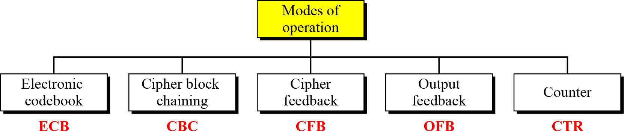
Modes of Operation Taxonomy
Current well-known modes of operation

Slide 44
Moe Technical Notes
Initialize Vector (IV)
a block of bits to randomize the encryption and hence to produce distinct ciphertext
Nonce : Number (used) Once
Random of psuedorandom number to ensure that past communications can not be reused in replay attacks
Some also refer to initialize vector as nonce
Padding
final block may require a padding to fit a block size
Method
Add null Bytes
Add 0x80 and many 0x00
Add the n bytes with value n

Slide 45
Electronic Codebook Book (ECB)
Message is broken into independent blocks which are encrypted
Each block is a value which is substituted, like a codebook, hence name
Each block is encoded independently of the other blocks
C_{i} = E_{K} (P_{i})
Uses: secure transmission of single values

Slide 46
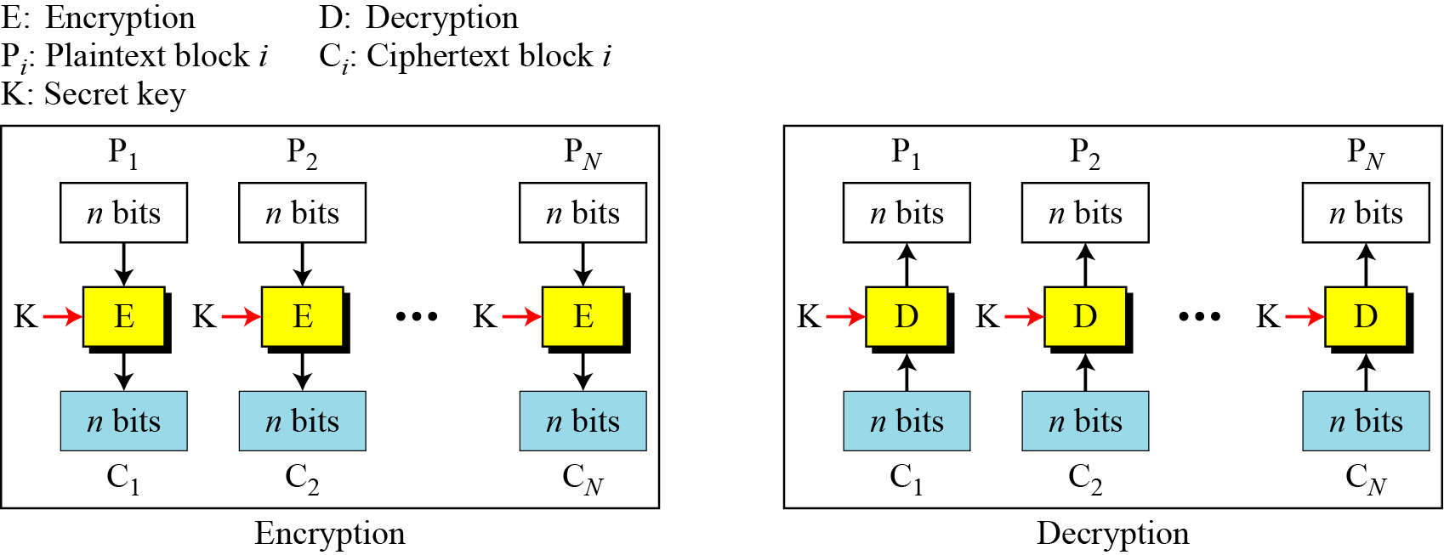
ECB Scheme
Notes:
Stallings Fig 3-11.

Slide 47
Remarks on ECB
Strength: it’s simple.
Weakness:
Repetitive data contained in the plaintext may show in the ciphertext, if aligned with blocks.
If the same message is encrypted (with the same key) and sent twice, their ciphertext are the same.
Typical application:
secure transmission of short pieces of information (e.g. a temporary encryption key)

Slide 48
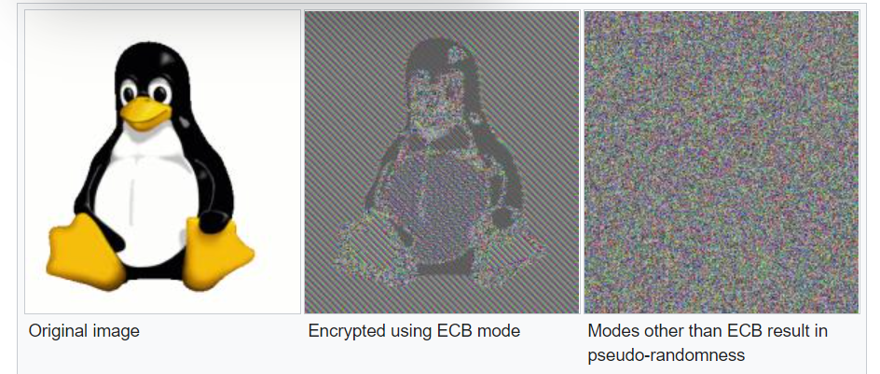
Remarks on ECB

Slide 49
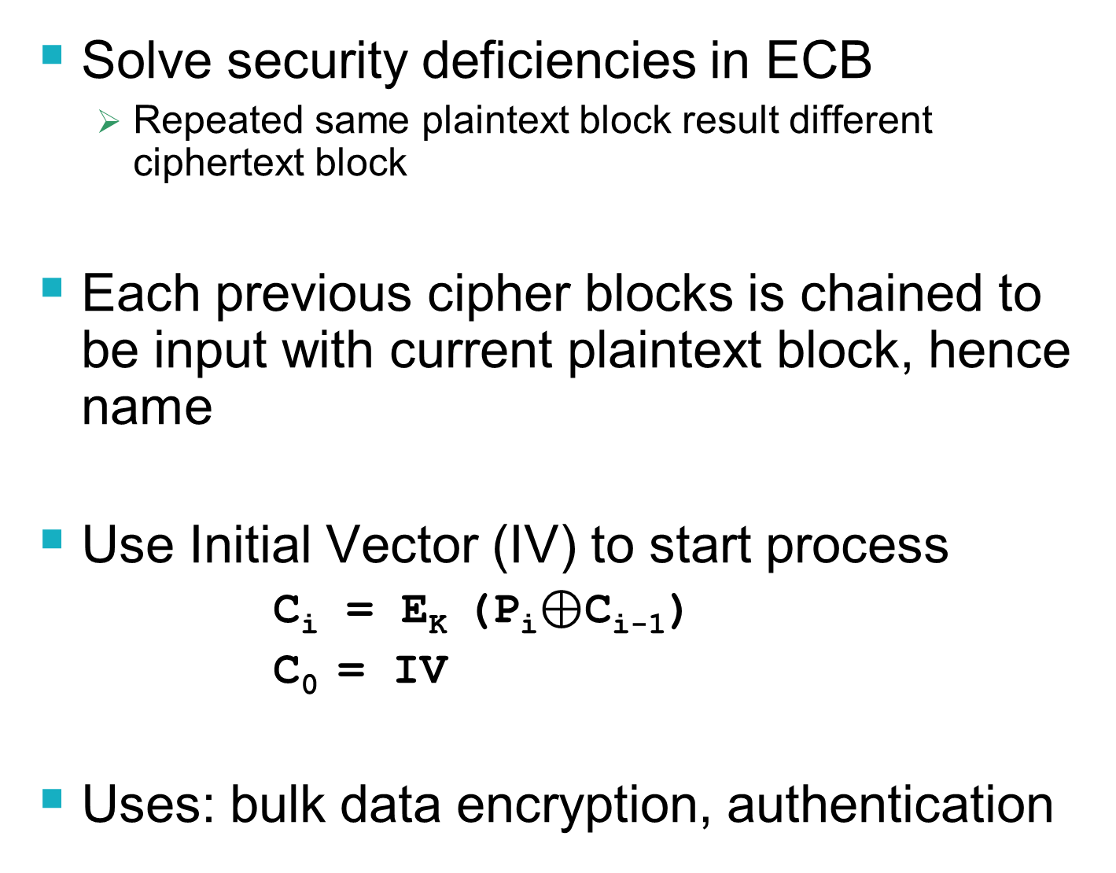
Cipher Block Chaining (CBC)
Solve security deficiencies in ECB
Repeated same plaintext block result different ciphertext block
Each previous cipher blocks is chained to be input with current plaintext block, hence name
Use Initial Vector (IV) to start process
C_{i} = E_{K} (P_{i}$⊕$C_{i-1})
C₀ = IV
Uses: bulk data encryption, authentication
Notes:
To overcome the problems of repetitions and order independence in ECB, want some way of making the ciphertext dependent on all blocks before it. This is what CBC gives us, by combining the previous ciphertext block with the current message block before encrypting. To start the process, use an Initial Value (IV), which is usually well known (often all 0's), or otherwise is sent, ECB encrypted, just before starting CBC use. CBC mode is applicable whenever large amounts of data need to be sent securely, provided that its available in advance (eg email, FTP, web etc)

Slide 50
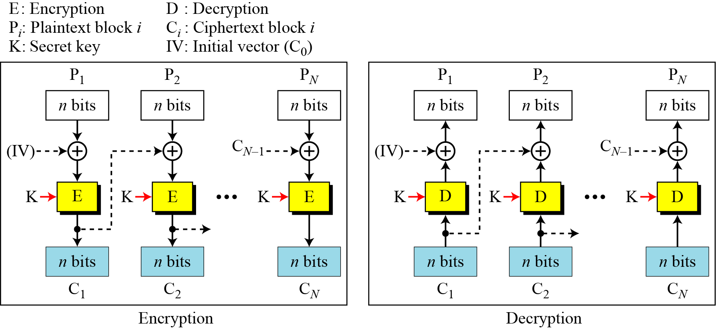
CBC scheme
Notes:
Stallings Fig 3-12.

Slide 51
Remarks on CBC
The encryption of a block depends on the current and all blocks before it.
So, repeated plaintext blocks are encrypted differently.
Initialization Vector (IV)
May sent encrypted in ECB mode before the rest of ciphertext

Slide 52
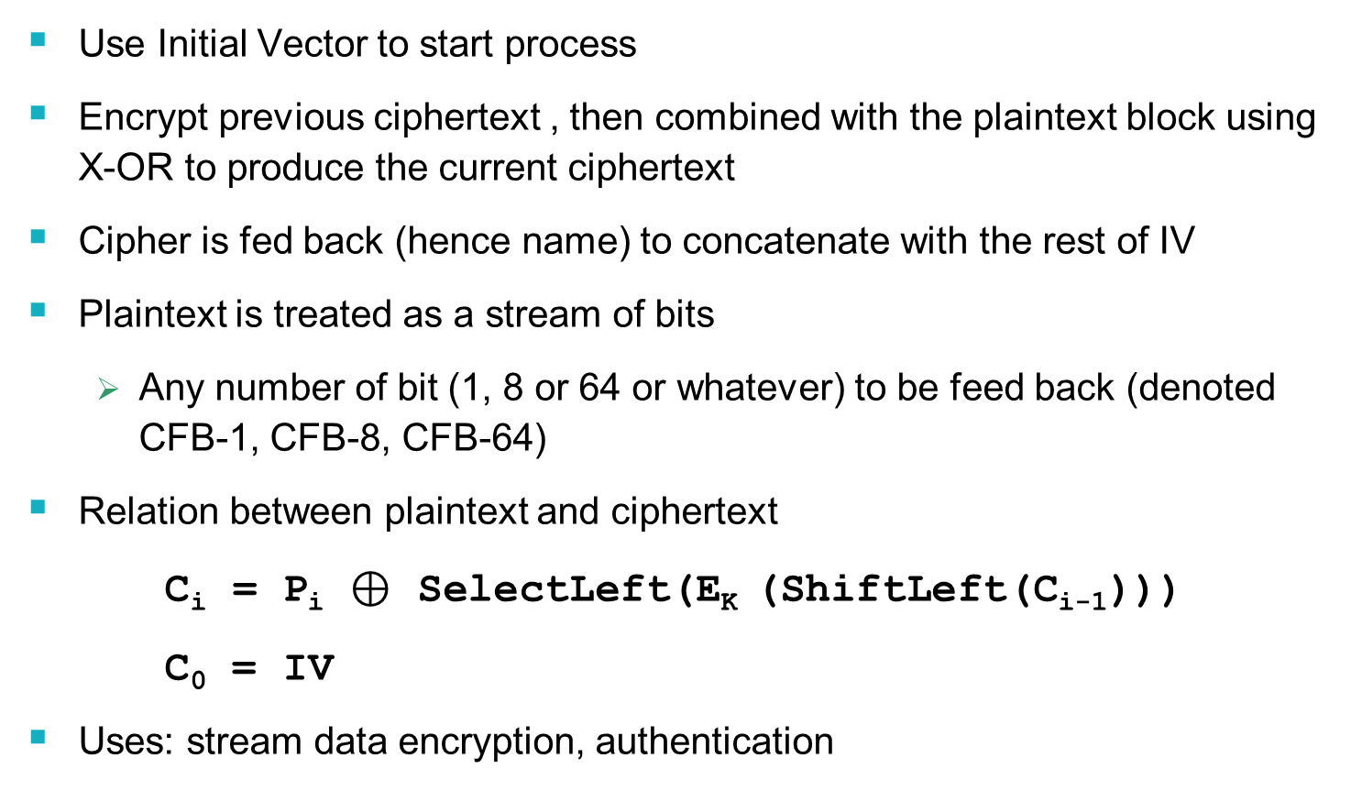
Cipher FeedBack (CFB)
Use Initial Vector to start process
Encrypt previous ciphertext , then combined with the plaintext block using X-OR to produce the current ciphertext
Cipher is fed back (hence name) to concatenate with the rest of IV
Plaintext is treated as a stream of bits
Any number of bit (1, 8 or 64 or whatever) to be feed back (denoted CFB-1, CFB-8, CFB-64)
Relation between plaintext and ciphertext
C_{i} = P_{i} $⊕$ SelectLeft(E_{K} (ShiftLeft(C_{i-1})))
C₀ = IV
Uses: stream data encryption, authentication
Notes:
If the data is only available a bit/byte at a time (eg. terminal session, sensor value etc), then must use some other approach to encrypting it, so as not to delay the info. Idea here is to use the block cipher essentially as a pseudo-random number generator (see stream cipher lecture later) and to combine these "random" bits with the message. Note as mentioned before, ⊕ is an easily inverted operator (just ⊕ with same thing again to undo). Again start with an IV to get things going, then use the ciphertext as the next input. As originally defined, idea was to "consume" as much of the "random" output as needed for each message unit (bit/byte) before "bumping" bits out of the buffer and re-encrypting. This is wasteful though, and slows the encryption down as more encryptions are needed. An alternate way to think of it is to generate a block of "random" bits, consume them as message bits/bytes arrive, and when they're used up, only then feed a full block of ciphertext back. This is CFB-64 mode, the most efficient. This is the usual choice for quantities of stream oriented data, and for authentication use.

Slide 53
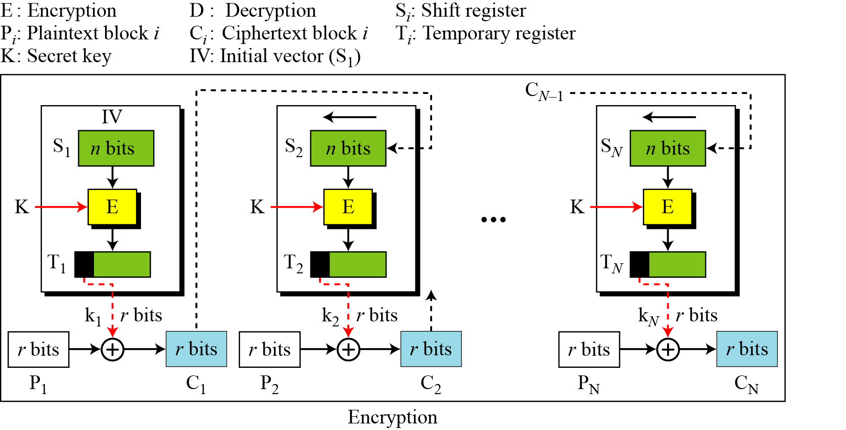
CFB Scheme

Slide 54
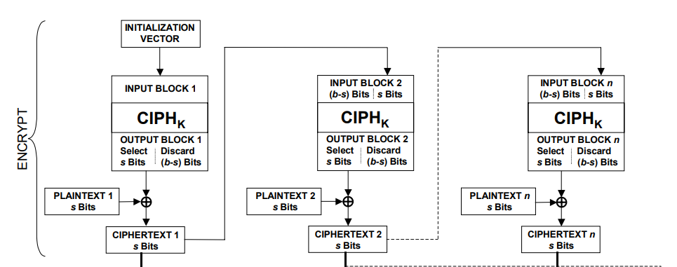
CFB Encryption/Decryption
Notes:
Stallings Fig 3-13.

Slide 55
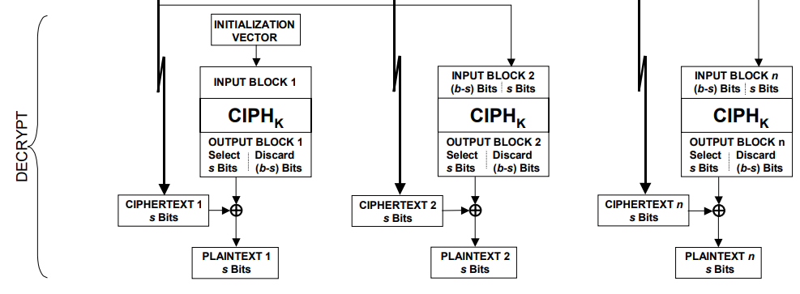
CFB Encryption/Decryption
Notes:
Stallings Fig 3-13.

Slide 56
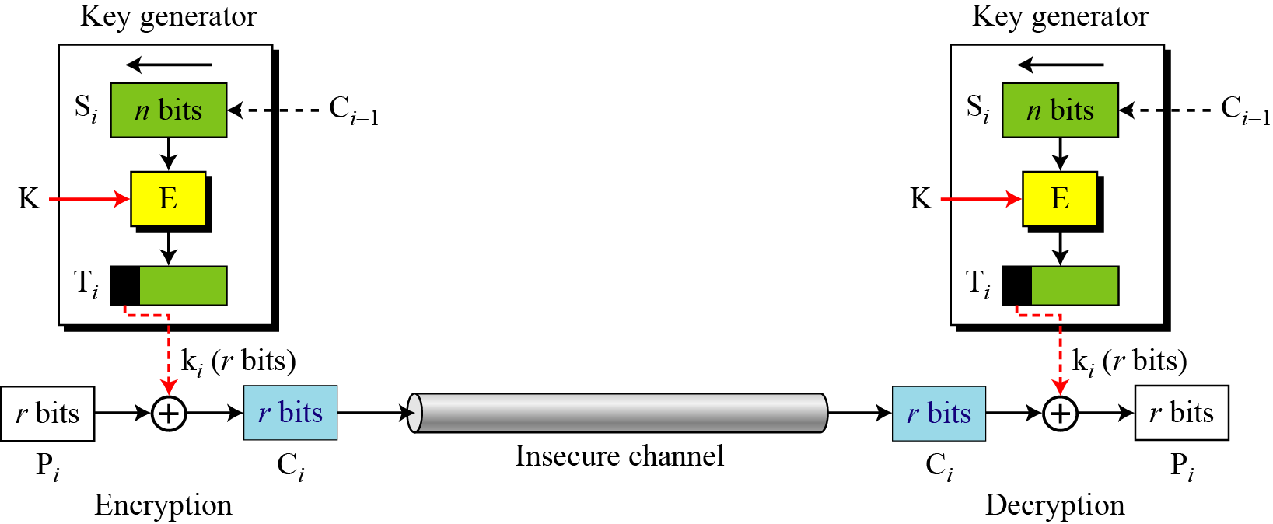
CFB as a Stream Cipher
In CFB mode, encipherment and decipherment use the encryption function of the underlying block cipher.

Slide 57
Remark on CFB
The block cipher is used as a stream cipher.
enable to encrypt any number of bits e.g. single bits or single characters (bytes)
S=1 : bit stream cipher
S=8 : character stream cipher
S=64, S=128 (block cipher)
A ciphertext segment depends on the current and all preceding plaintext segments.
A corrupted ciphertext segment during transmission will affect the current and next several plaintext segments.

Slide 58
Output FeedBack (OFB)
Very similar to CFB
But output of the encryption function output of cipher is fed back (hence name), instead of ciphertext
Feedback is independent of message
Relation between plaintext and ciphertext
C_{i} = P_{i} ⊕ O_{i}
O_{i} = E_{K} (O_{i-1})
O₀ = IV
Uses: stream encryption over noisy channels
Notes:
The alternative to CFB is OFB. Here the generation of the "random" bits is independent of the message being encrypted. The advantage is that firstly, they can be computed in advance, good for bursty traffic, and secondly, any bit error only affects a single bit. Thus this is good for noisy links (eg satellite TV transmissions etc).

Slide 59
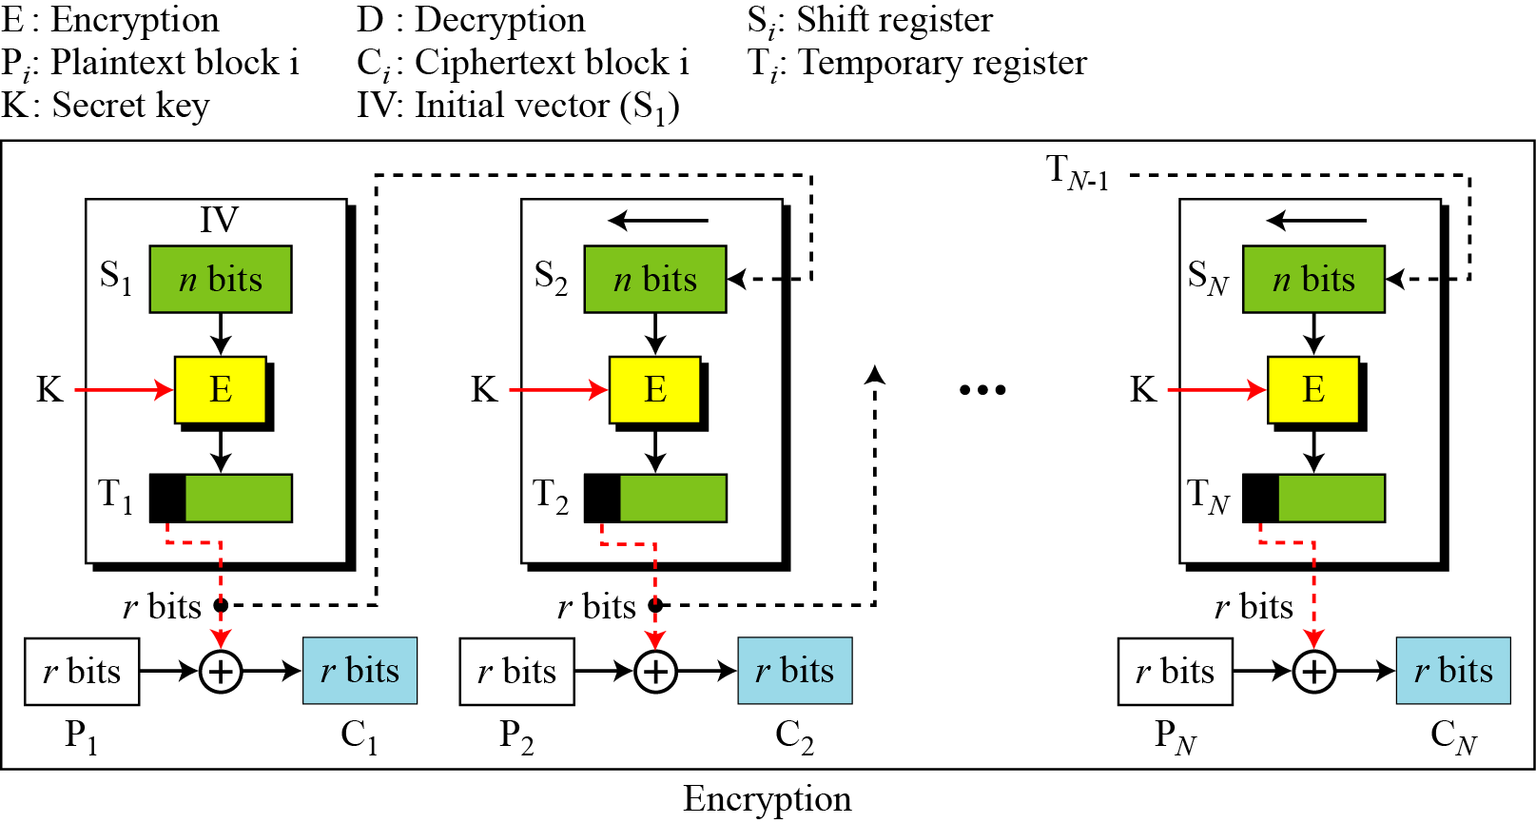
OFB Scheme

Slide 60
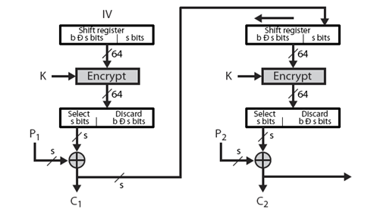
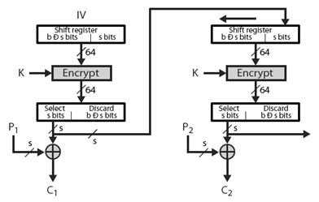
CFB V.S. OFB
Cipher Feedback
Output Feedback

Slide 61
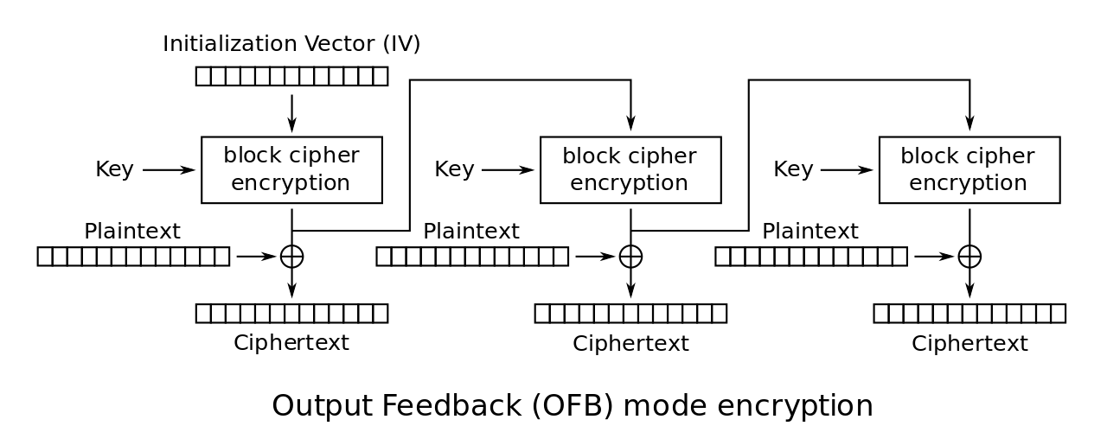
OFB Encryption and Decryption
Notes:
Stallings Fig 3-14.

Slide 62
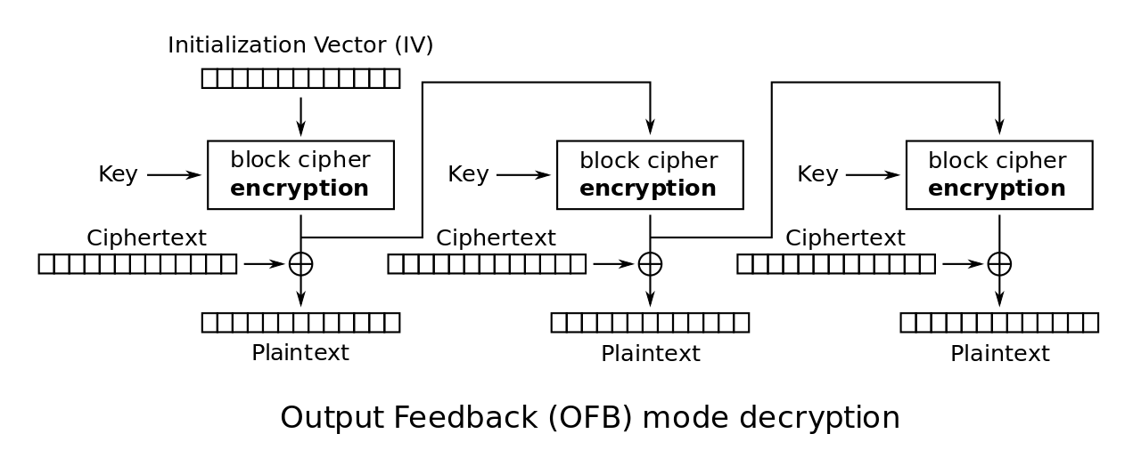
OFB Encryption and Decryption
Notes:
Stallings Fig 3-14.

Slide 63
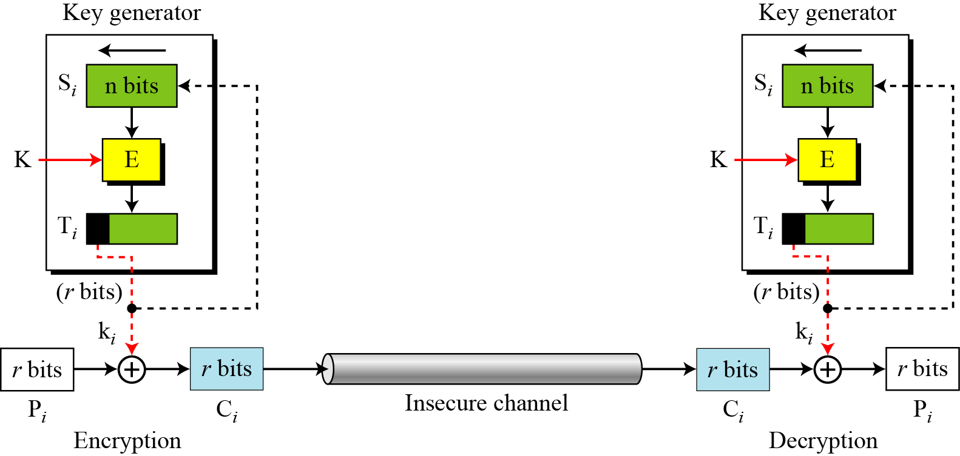
OFB as a Stream Cipher
In OFB mode, encipherment and decipherment use the encryption function of the underlying block cipher.

Slide 64
Remarks on OFB
Each bit in the ciphertext is independent of the previous bit or bits. This avoids error propagation
Pre-compute of forward cipher is possible
Security issue
when j^{th} plaintext is known, the j^{th} output of the forward cipher function will be known
Easily cover j^{th} plaintext block of other message with the same IV
Require that the IV is a nonce
Notes:
Because the "random" bits are independent of the message, they must never ever be used more than once (otherwise the 2 ciphertexts can be combined, cancelling these bits, and leaving a "book" cipher to solve). Also, as noted, should only ever use a full block feedback ie OFB-64 mode.

Slide 65
Counter (CTR)
Encrypts counter value with the key rather than any feedback value (no feedback)
Counter for each plaintext will be different
can be any function which produces a sequence which is guaranteed not to repeat for a long time
Relation
C_{i} = P_{i} ⊕ O_{i}
O_{i} = E_{K} (i)
Uses: high-speed network encryptions

Slide 66
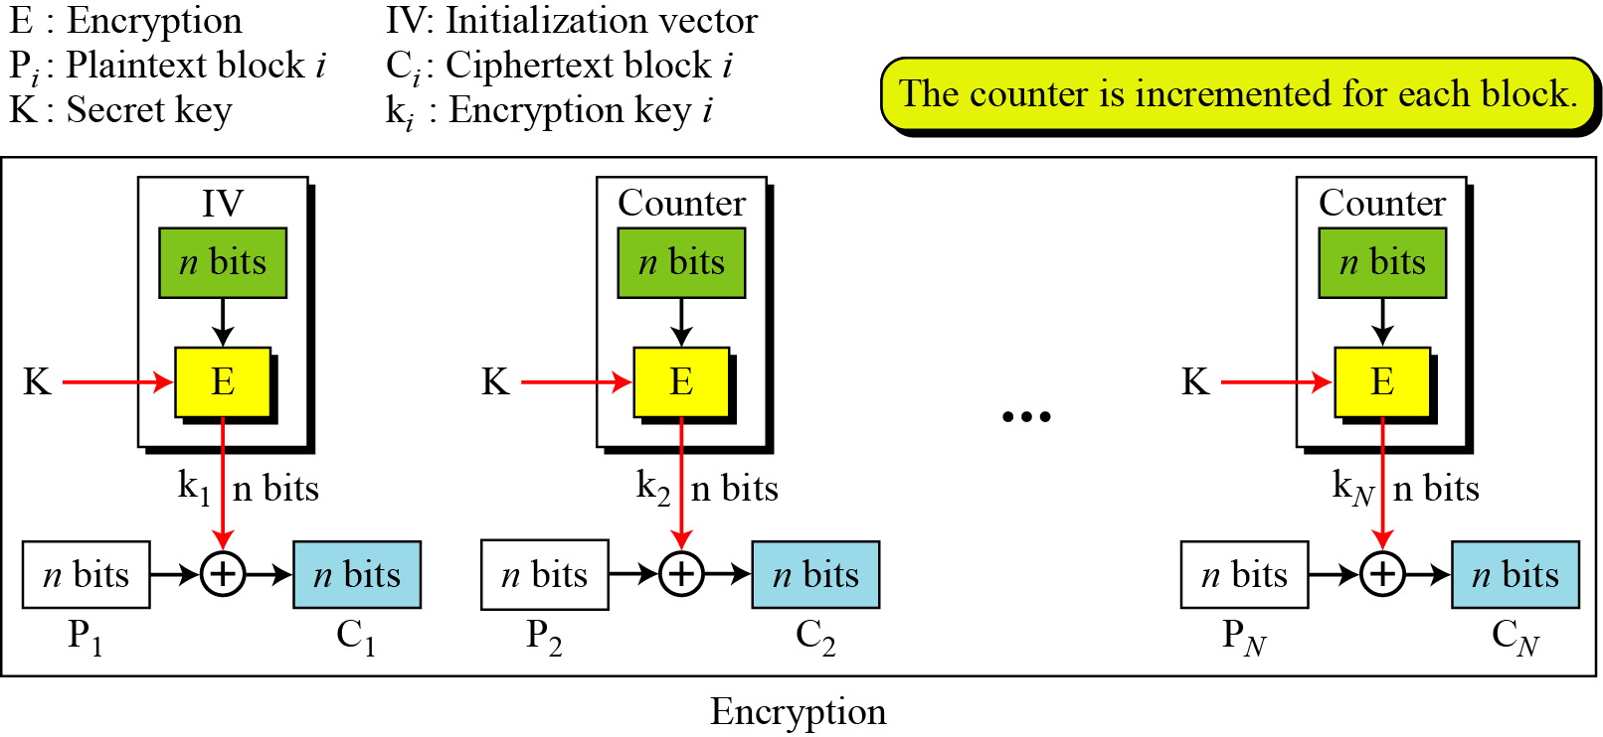
CTR Scheme

Slide 67
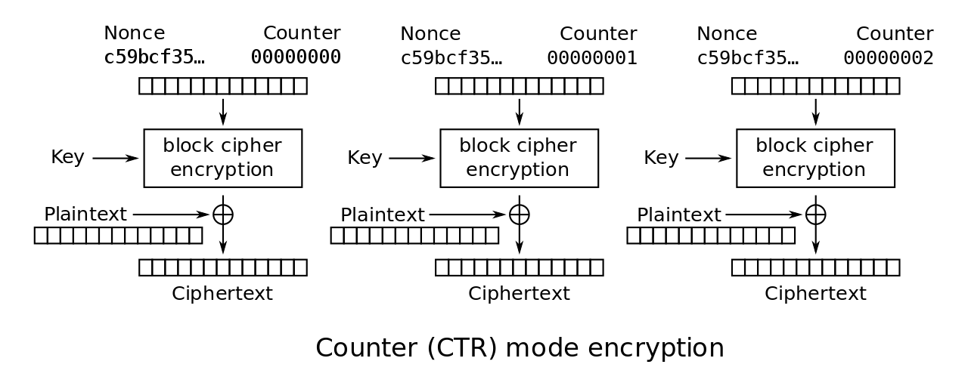
CTR Encryption and Decryption
Notes:
Stallings Fig 3-15.

Slide 68
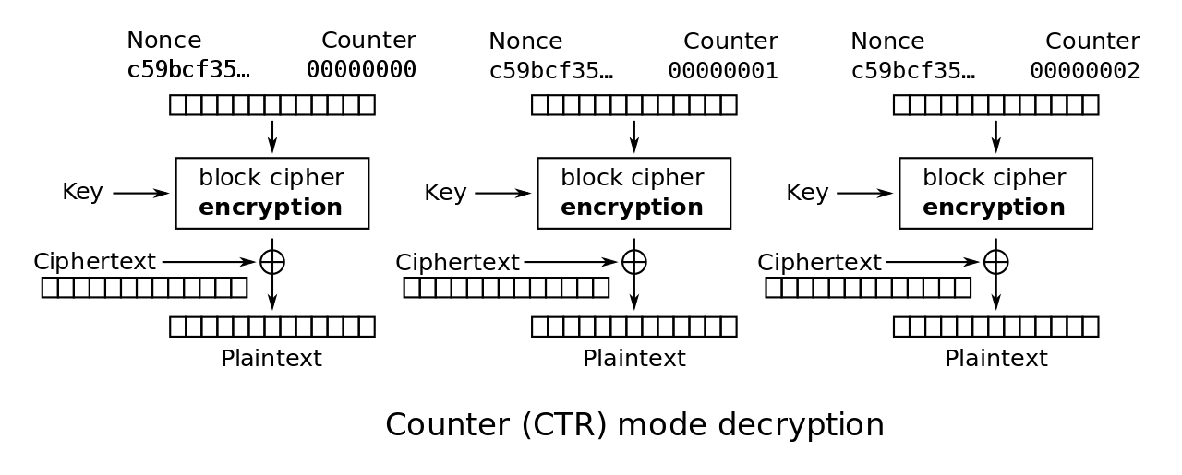
CTR Encryption and Decryption
Notes:
Stallings Fig 3-15.

Slide 69
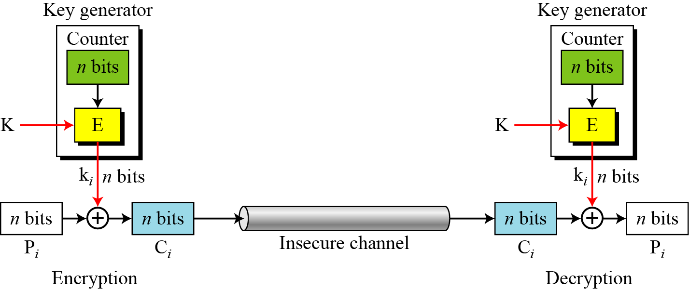
OFB as a Stream Cipher

Slide 70
Remark on CTR
Strengthes:
Needs only the encryption algorithm
Random access to encrypted data blocks
blocks can be processed (encrypted or decrypted) in parallel
Simple; fast encryption/decryption
Counter must be
Must be unknown and unpredictable
pseudo-randomness in the key stream is a goal

Slide 71
Remark on each mode
Basically two types:
block cipher
stream cipher
CBC is an excellent block cipher
CFB, OFB, and CTR are stream ciphers
CTR is faster because simpler and it allows parallel processing

Slide 72
Modes and IV
An IV has different security requirements than a key
Generally, an IV will not be reused under the same key
CBC and CFB
reusing an IV leaks some information about the first block of plaintext, and about any common prefix shared by the two messages
OFB and CTR
reusing an IV completely destroys security

Slide 73
CBC and CTR comparison
CBC | CTR
Padding needed | No padding
No parallel processing | Parallel processing
Separate encryption and decryption functions | Encryption function alone is enough
Random IV or a nonce | Unique nonce
Nonce reuse leaks some information about initial plaintext block | Nonce reuse will leak information about the entire message

Slide 74
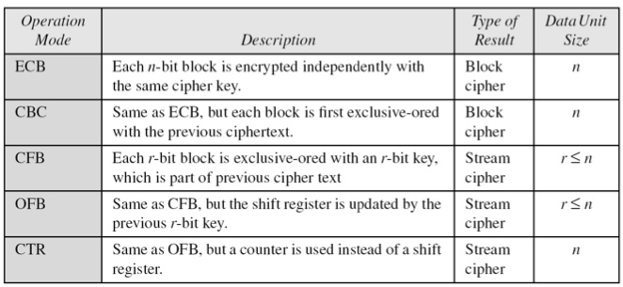
Comparison of Different Modes

Slide 75
Comparison of Modes
Mode | Description | Application
ECB | 64-bit plaintext block encoded separately | Secure transmission of encryption key
CBC | 64-bit plaintext blocks are XORed with preceding 64-bit ciphertext | Commonly used method. Used for authentication
CFB | s bits are processed at a time and used similar to CBC | Primary stream cipher. Used for authentication

Slide 76
Comparison of Modes
Mode | Description | Application
OFB | Similar to CFB except that the output is fed back | Stream cipher well suited for transmission over noisy channels
CTR | Key calculated using the nonce and the counter value. Counter is incremented for each block | General purpose block oriented transmission. Used for high-speed communications

Slide 77
Final Notes
ECB, CBC, OFB, CFB, CTR, and XTS modes only provide confidentiality
To ensure an encrypted message is not accidentally modified or maliciously tampered requires a separate Message Authentication Code (MAC)
Several MAC schemes
HMAC, CMAC and GMAC
But.. compositing a confidentiality mode with an authenticity mode could be difficult and error prone
New modes combined confidentiality and data integrity into a single cryptographic primitive
CCM, GCM, CWC, EAX, IAPM and OCB

